Slide 1
Парсинг и визуализация логов CUCM
Курсовой проект OTUS по курсу
Observability - мониторинг, логирование, трейсинг

Slide 2
Общая схема

Slide 3
Часть 1
Доставка и парсинг
Filebeat – Kafka – Logstash - Elasticsearch

Slide 4
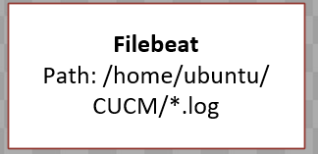
Пример лога CUCM
12:39:27.307 |LogMessage UserID : mochidateruo ClientAddress : 172.24.171.12 Severity : 6 EventType : UserLogging ResourceAccessed: cucm-uds EventStatus : Success CompulsoryEvent : No AuditCategory : AdministrativeEvent ComponentID : cucm-uds CorrelationID : AuditDetails : Login Authentication Successful App ID: Cisco Tomcat Cluster ID: Node ID: CCM2
20:48:51.864 |LogMessage UserID : elenavn ClientAddress : 172.24.171.12 Severity : 3 EventType : UserLogging ResourceAccessed: cucm-uds EventStatus : Failure CompulsoryEvent : No AuditCategory : AdministrativeEvent ComponentID : cucm-uds CorrelationID : AuditDetails : Login Authentication Failed App ID: Cisco Tomcat Cluster ID: Node ID: CCM2

Slide 5
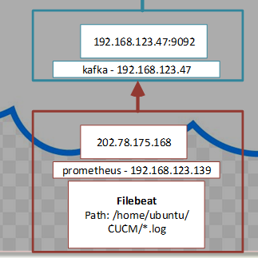
filebeat.yml
filebeat.inputs:
- type: filestream
id: my-filestream-id
enabled: true
paths:
- /home/ubuntu/CUCM/*.log
output.kafka:
hosts: ["192.168.123.47:9092"]
topic: "filebeat"
partition.round_robin:
reachable_only: false
required_acks: 1
compression: gzip
max_message_bytes: 1000000
close_inactive: 10m

Slide 6
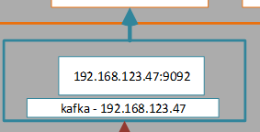
kafka docker-compose.yml
services:
kafka1:
image: confluentinc/cp-kafka:5.5.1
hostname: kafka1
ports:
- "9092:9092"
- "9999:9999"
environment:
KAFKA_ADVERTISED_LISTENERS: LISTENER_DOCKER_INTERNAL://kafka1:9092,LISTENER_DOCKER_EXTERNAL://192.168.123.47:9092
KAFKA_LISTENER_SECURITY_PROTOCOL_MAP: LISTENER_DOCKER_INTERNAL:PLAINTEXT,LISTENER_DOCKER_EXTERNAL:PLAINTEXT
KAFKA_INTER_BROKER_LISTENER_NAME: LISTENER_DOCKER_INTERNAL
KAFKA_ZOOKEEPER_CONNECT: "zoo1:2181"
KAFKA_BROKER_ID: 1
KAFKA_LOG4J_LOGGERS: "kafka.controller=INFO,kafka.producer.async.DefaultEventHandler=INFO,state.change.logger=INFO"
KAFKA_OFFSETS_TOPIC_REPLICATION_FACTOR: 1
KAFKA_TRANSACTION_STATE_LOG_REPLICATION_FACTOR: 1
KAFKA_TRANSACTION_STATE_LOG_MIN_ISR: 1
KAFKA_JMX_PORT: 9999
KAFKA_JMX_HOSTNAME: 192.168.123.47
volumes:
- ./zk-single-kafka-single/kafka1/data:/var/lib/kafka/data
depends_on:
- zoo1
zoo1:
image: zookeeper:3.4.9
hostname: zoo1
ports:
- "2181:2181"
environment:
ZOO_MY_ID: 1
ZOO_PORT: 2181
ZOO_SERVERS: server.1=zoo1:2888:3888
volumes:
- ./zk-single-kafka-single/zoo1/data:/data
- ./zk-single-kafka-single/zoo1/datalog:/datalog

Slide 7
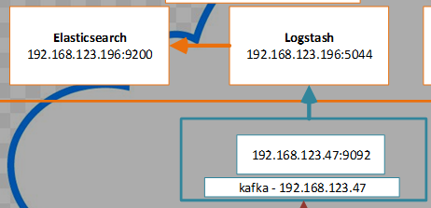
Logstash logstash-CUCM.conf input/output
input {
kafka {
bootstrap_servers => "192.168.123.47:9092"
topics => "filebeat"
}
}
output {
elasticsearch {
hosts => ["https://localhost:9200"]
index => "kafka-cucm-%{+YYYY.MM.dd}"
user => "elastic"
password => "Ps7zec6JBMwWV-Pzz9tH"
cacert => "/home/ubuntu/http_ca.crt"
}
}

Slide 8

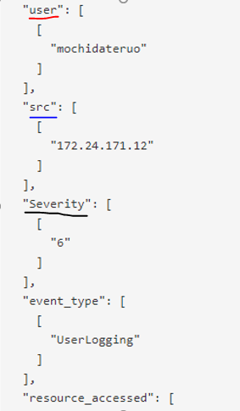
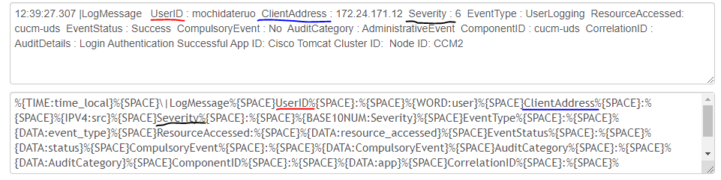
Logstash logstash-CUCM.conf filter json/grok
filter {
json { source => "message“ }
if "LogMessage" in [message] {
grok {
match => {
"message" => "%{TIME:time_local}%{SPACE…."
}
}
…

Slide 9
Logstash logstash-CUCM.conf filter mutate add_tag\replace\add_field
if [event_type] in "GeneralConfigurationUpdate" {
if "record in table" in [auditdetails] {
grok {
match => {
"auditdetails" => "record in table %{GREEDYDATA:change_type} with key field %{GREEDYDATA:object} = %{GREEDYDATA:object_id} %{GREEDYDATA:action}"
}
}
mutate {
replace => { "result" => "%{auditdetails}" }
add_tag => [ "change" ]
}
else if [event_type] in [ "UserAccess", "UserLogging" ] {
mutate {
add_tag => [ "authentication" ]
}
if "Login Authentication Successful" in [auditdetails] or "User is authorized to access" in [auditdetails] or "Successfully Logged into" in [auditdetails] {
mutate {
replace => { "action" => "success" }
}
else if "Login Authentication Failed" in [auditdetails] or "User is unauthorized to access" in [auditdetails] or "Failed to Log into" in [auditdetails] {
mutate {
replace => { "action" => "failure" }
}
else {
grok {
match => {
"message" => "%{GREEDYDATA:messageNOTparsed}"

Slide 10

Elasticsearch.yml
action.auto_create_index: .monitoring*,.watches,.triggered_watches,.watcher-history*,.ml*,l*,m*,f*,h*,k*
xpack.security.enabled: true
xpack.security.enrollment.enabled: true
xpack.security.http.ssl:
enabled: true
keystore.path: certs/http.p12
xpack.security.transport.ssl:
enabled: true
verification_mode: certificate
keystore.path: certs/transport.p12
truststore.path: certs/transport.p12
cluster.initial_master_nodes: ["elk"]
http.host: 0.0.0.0

Slide 11
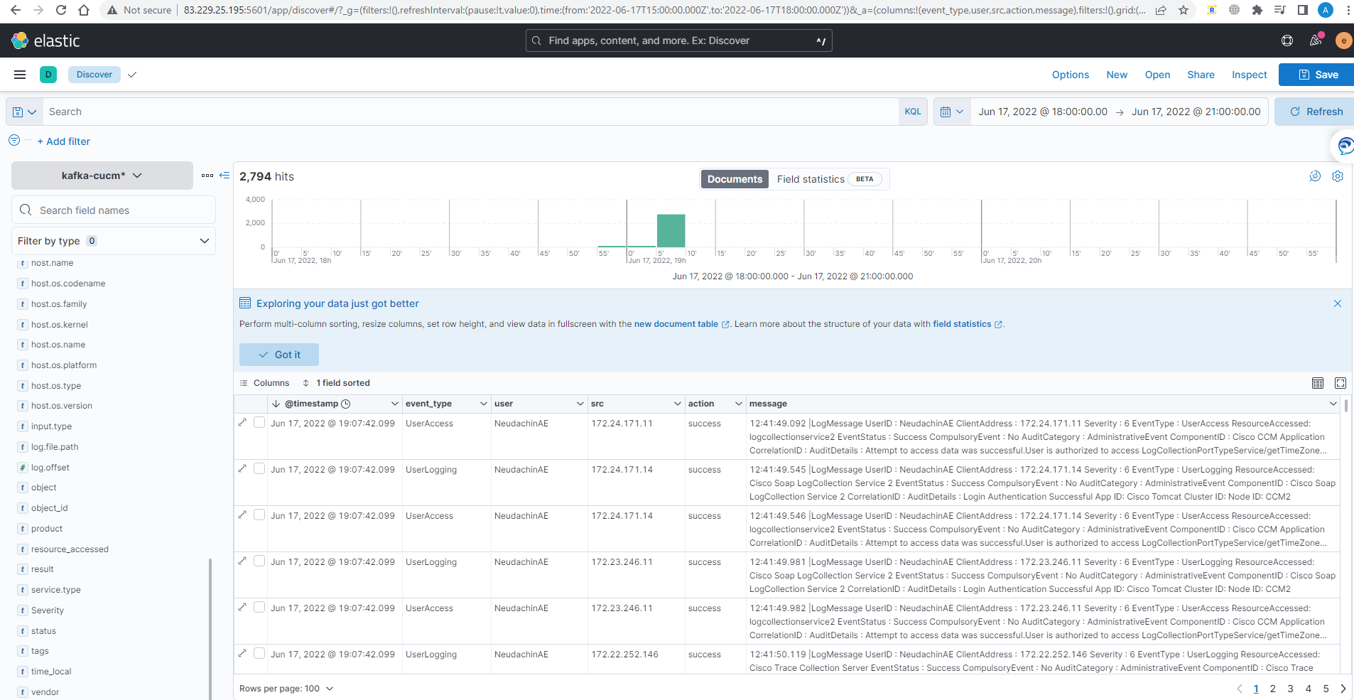
Elasticsearch результат

Slide 12
Часть 2
Визуализация
Elasticsearch – Kibana

Slide 13
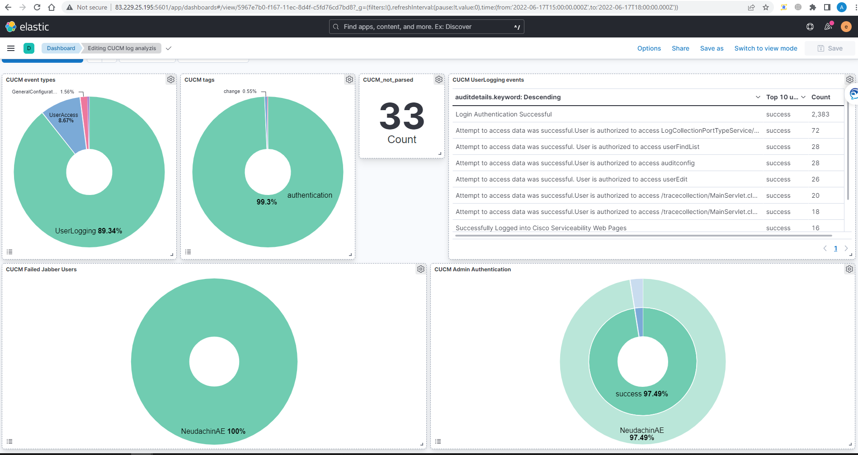
Kibana dashboard

Slide 14
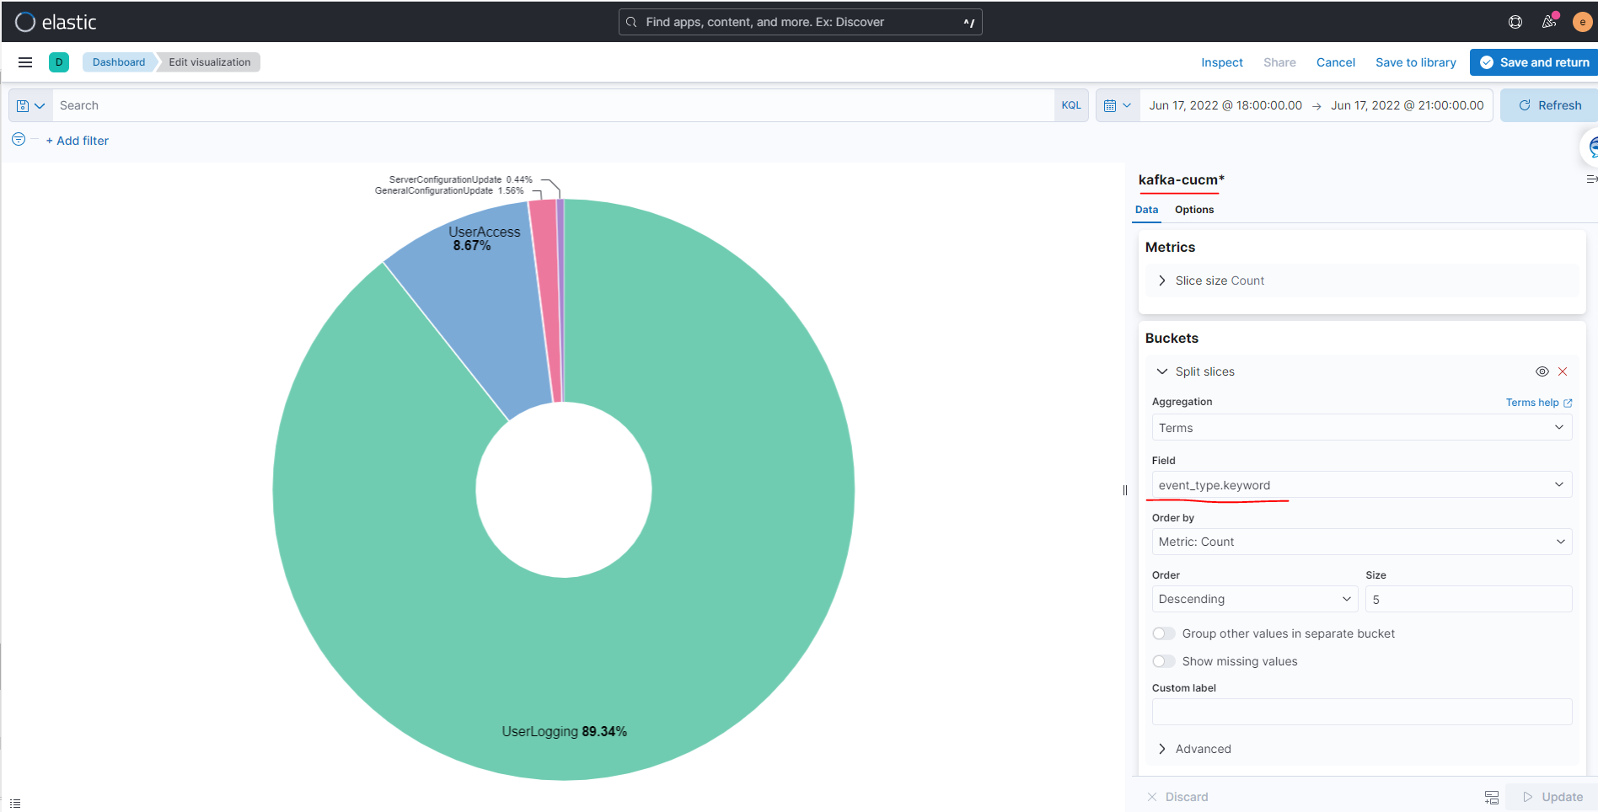
Kibana pie visualization Terms aggregation

Slide 15
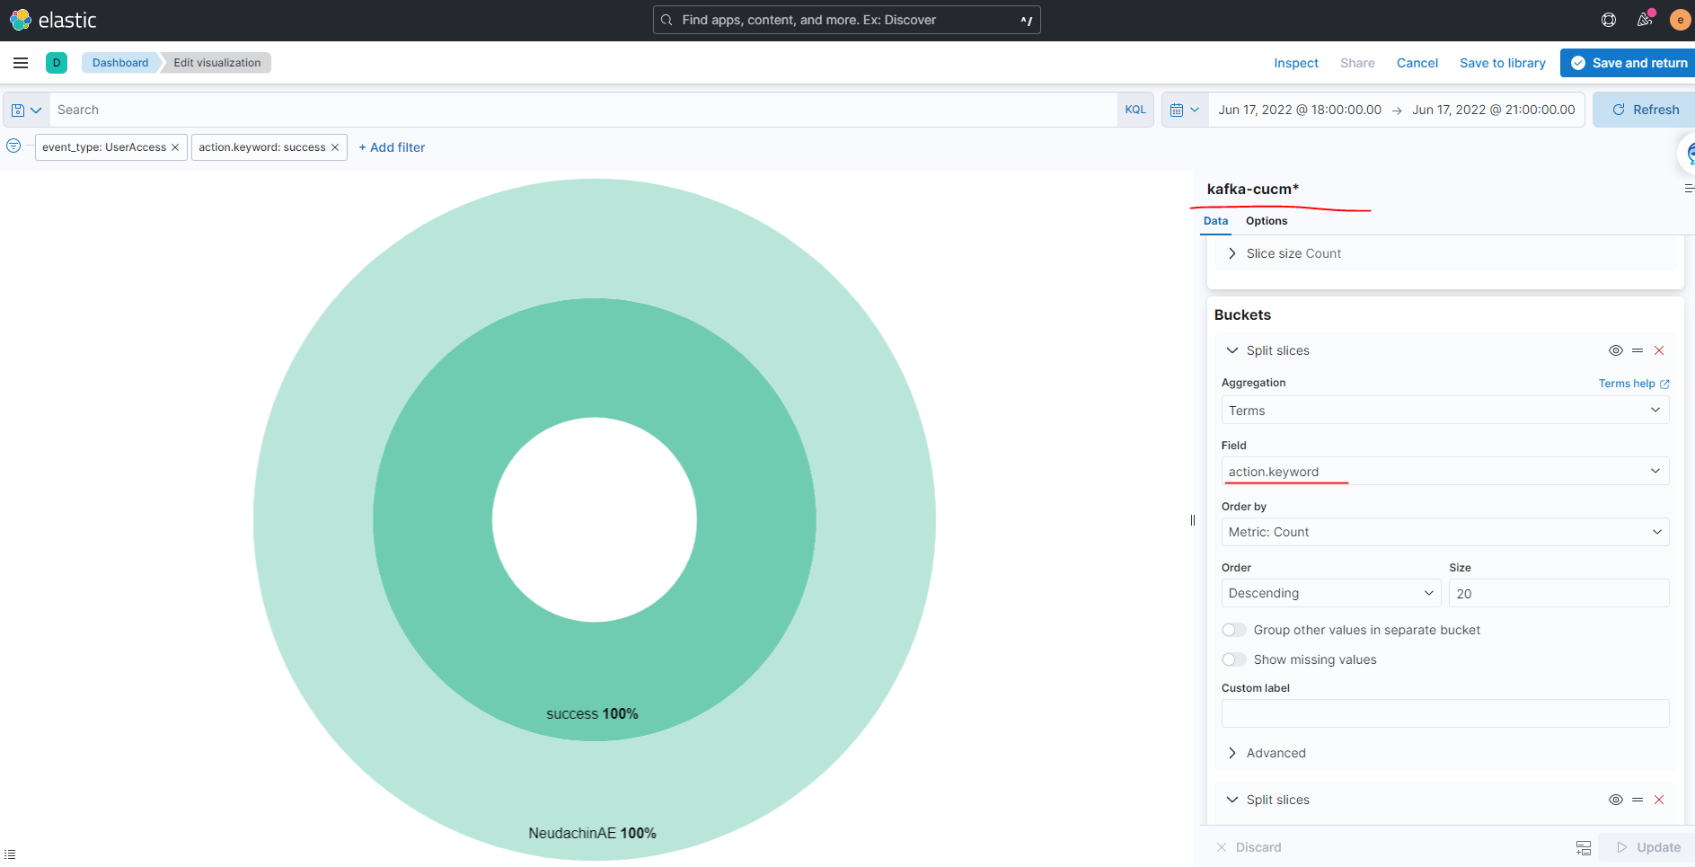
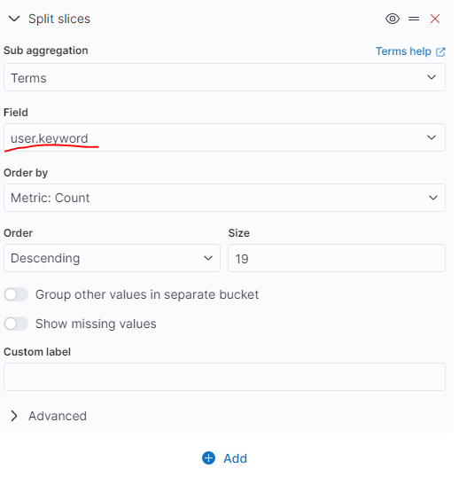
Kibana pie visualization Terms aggregation && sub aggregation

